Slide 1
Dashlane Password Manager
AU / PC Club Presentation – Feb. 19, 2020
Outline
Market Presence
Pro’s & Con’s
Strengths & Weaknesses
Features Overview
How to install
Practical Examples & PW Organization

Slide 2
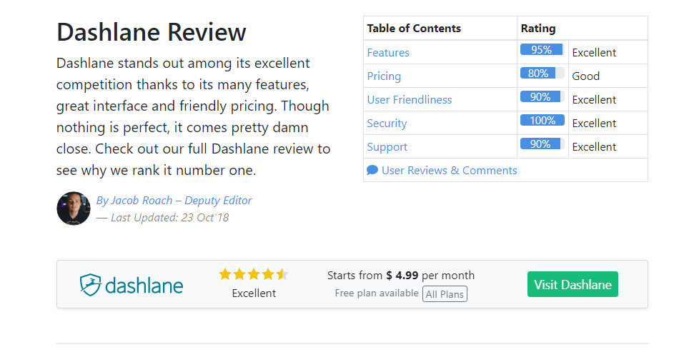
Source: URL: https://www.cloudwards.net/dashlane-review/
HIGH FUNCTION _ MANY FEATURE’s PASSWORD MANAGER

Slide 3
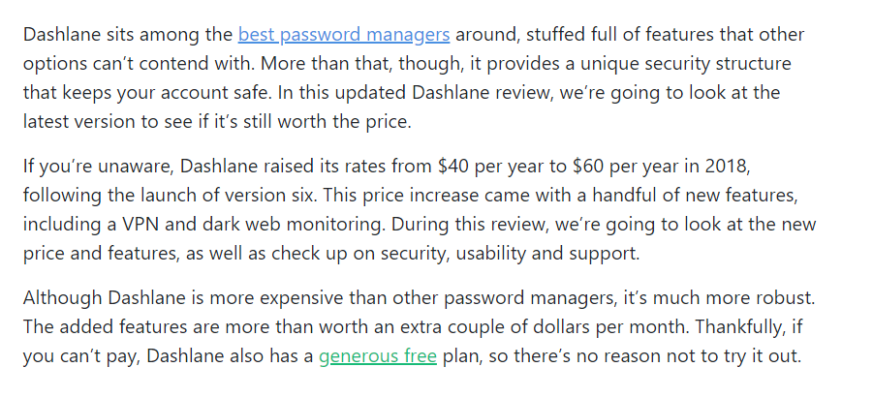

Slide 4
DASHLANE – PRO’s & CON’s
PROs
PC Based software app – Provides Privacy and Security
FREE & Fee Based versions
Requires your MASTER PASSWORD to activate & view your each web access site PW
Allows User editing – Helpful for CUSTOM NAMES
Easy to edit existing app icons
Provides many ICONS for quick finding – ie, Amazon, Google, Fidelity, Walgreens
All apps are ALPHA Sorted automatically (in a PW encrypted Vault)
MUST OPEN WITH A PASSWORD TO ACTIVATE at START UP or AFTER CLOSING
Reasonable learning curve
Few usage issues
Works well for about + 90% of apps selected
Some sites have security measures to prevent auto log-in
Examples are banks & financial institutions (constantly changing)
Allows for Web “Form Fill” info storage (name, address, credit card, web purchase receipts)
CONs
Learning Curve
Some Applications may not accept auto log-in or create difficulty to work easily
How to determine “what’s wrong” – “why won’t it work?”
Dashlane USER Support (3 options) - EMAIL / - WEBSITE Q&A / CHAT (online) – M to F / NO Phone Support

Slide 5
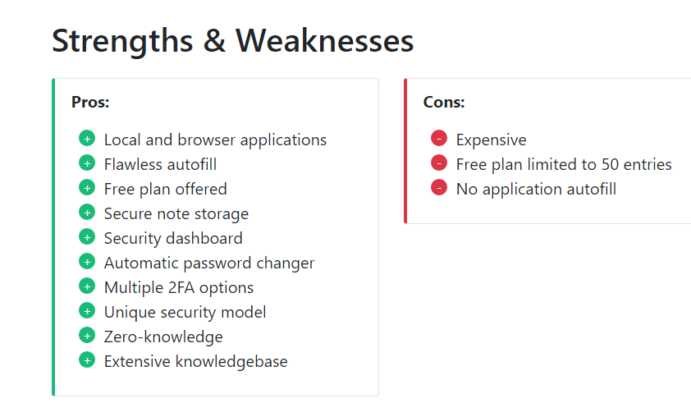

Slide 6
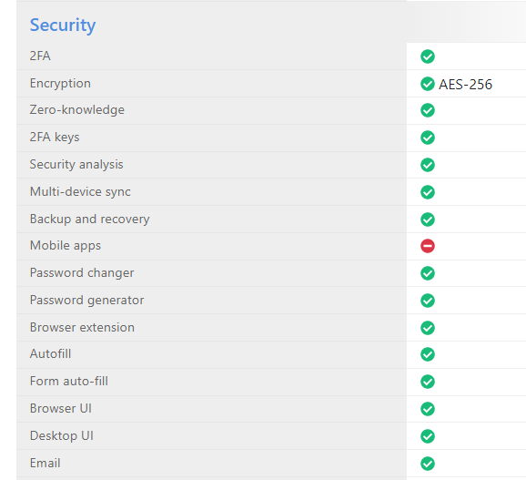
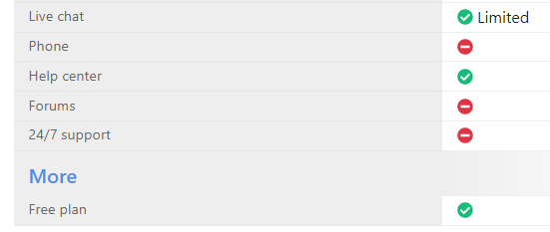
Dashlane Features Overview

Slide 7
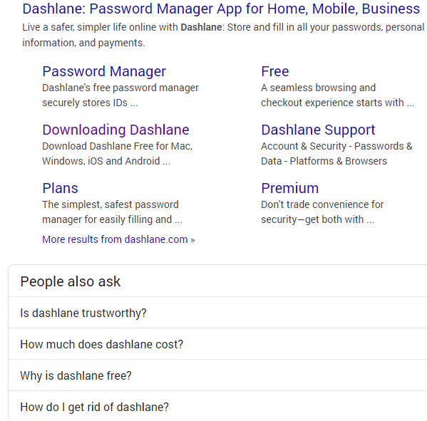
How do you find & Install Dashlane?

Slide 8
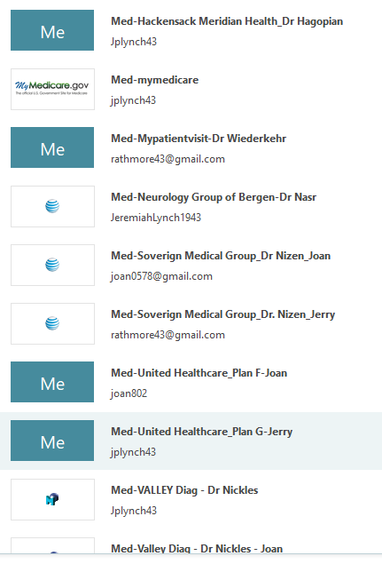





Password Examples – How to Organize
Hackensack Meridian
Neurology Group
United Healthcare
Google
Amazon
Acme
Apple
Rockland Electric
Quest Diagnostics?
=========
Jerry
Joan

